Slide 1
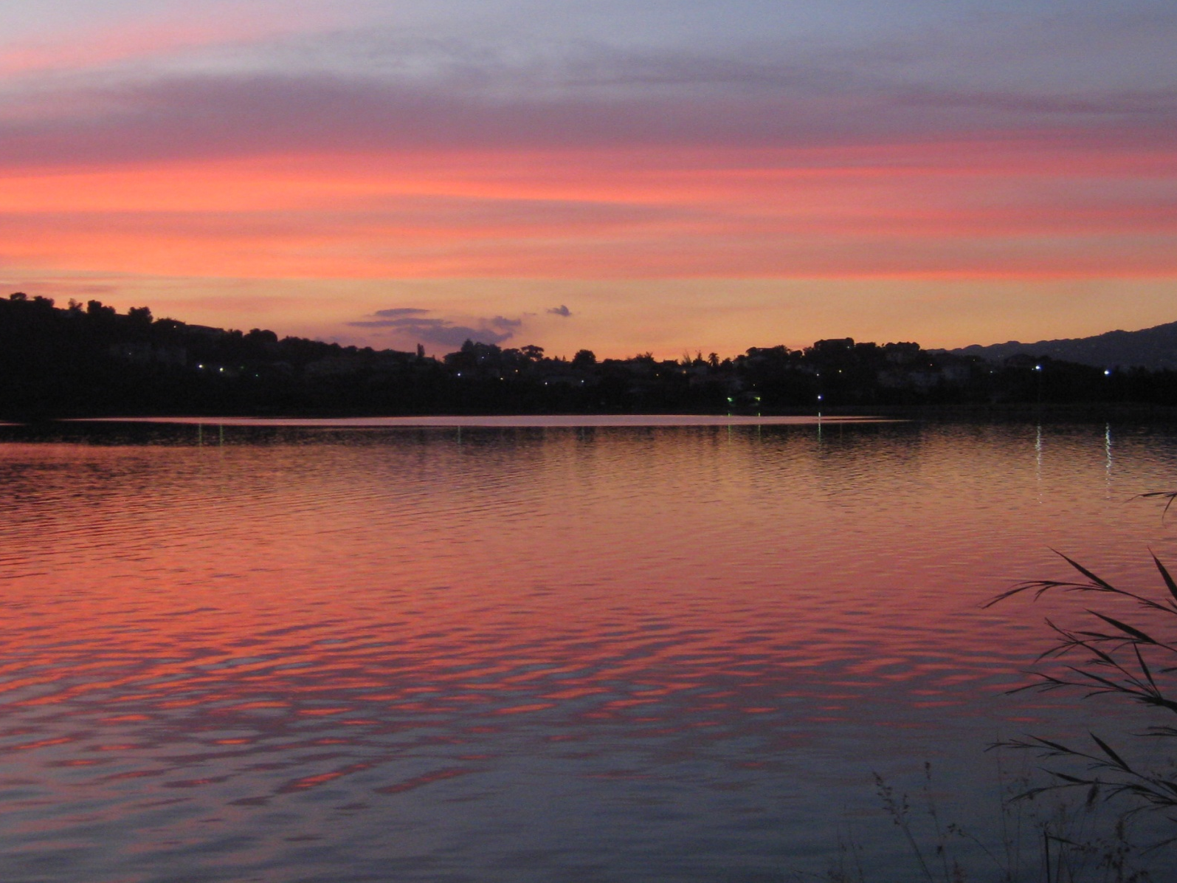
Institute for the Study of the Americas
Fifty Years of Independence: Jamaica’s Development and Impact as a Sovereign State
February 10, 2012
Jamaica’s Environment in the Post-Colonial Era:
resources, risk(s) and responses
Dr David Dodman
International Institute for Environment and Development
david.dodman@iied.org

Slide 2
Jamaica’s Environment in the Post-Colonial Era
viewing Jamaica’s natural environment: valueless, paradise, all-encompassing?
environmental resources
risks and risk: threats to the natural environment threats from ‘natural’ disasters and climate change
responding to the environmental challenge past successes current efforts remaining challenges

Slide 3
Approaching Jamaica’s Environment
“The view that land is valueless save as a commodity persists in many aspects of West Indian life today. It affects agricultural development programmes which exalt production but neglect stability of tenure. It is evident in the readiness of individuals and governments to sell and lease land to foreign corporations, and in the easy faith that the highest income per acre is the greatest national good.”
David Lowenthal (1961) Caribbean Views of Caribbean Land

Slide 4
Approaching Jamaica’s Environment
“The familiar sun-sea-and-sand imagery [and] an ecotourism imagery of ‘unspoilt’ primal rainforests, waterfalls, and lush greenery… pick up on longstanding visual and literary themes in Western culture based on the idea of tropical islands as microcosms of earthly Paradise.”
Mimi Sheller (2003)
Consuming the Caribbean

Slide 5
Approaching Jamaica’s Environment
“When you ask people in Jamaica about their environment, some immediately refer to the cutting down of trees, some to the problems of garbage and litter, some to the problems of drains and the unhealthy conditions of stagnant water, the problems of sanitation in the inner city, while others even refer to the issues of safety and respectability in their community, the problems of crime, stress and tension. All are correct in referring to their environment in these disparate ways, for the environment is not a single or simple element but a composite of nature, ‘man-made’ structures and societal factors.”
Elizabeth Thomas-Hope (1996)
The Environmental Dilemma in Caribbean Context

Slide 6
Risks: Key Environmental Challenges
forestry, agriculture, watershed management
water resource problems
coastal and marine resources
air pollution
waste management
human settlements
environment and health

Slide 7
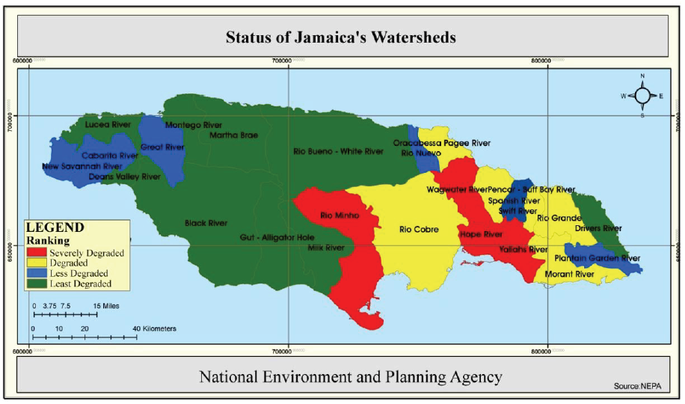

Slide 8
Risk: Environmental Hazards
‘natural’ disasters
climate change

Slide 9
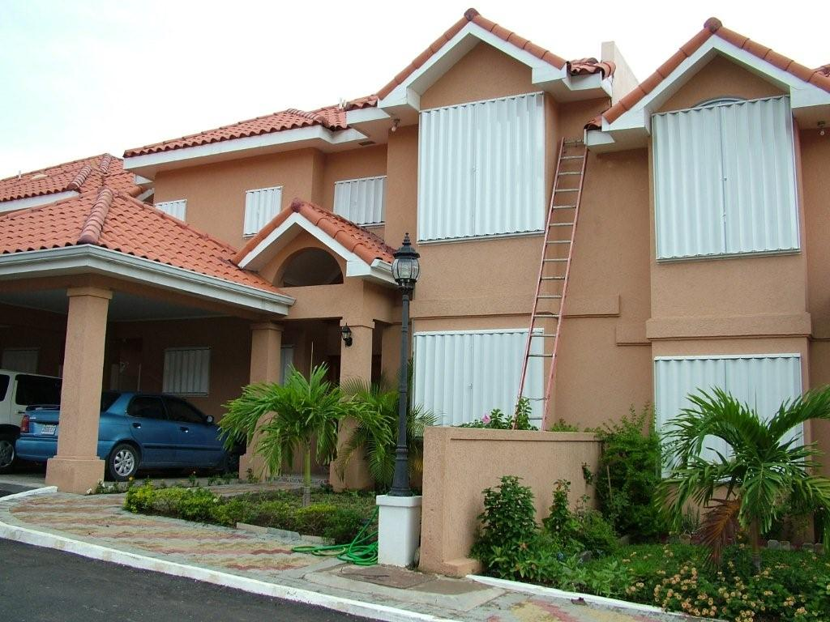
Climate change: the good news
Low-confidence in any observed long-term increases in tropical cyclone activity
Likely that global frequency of tropical cyclones will either decrease or remain essentially unchanged
IPCC (2012). Special Report on Managing the Risks of Extreme Events – Summary for Policymakers.

Slide 10
Climate change: the bad news
Increased losses from hurricanes expected due to population growth and increased property values
“Small islands have characteristics that make them especially vulnerable to the effects of climate change, sea-level rise and extreme weather- climate- and ocean-related events.”
[preliminary conclusion from IPCC Fifth Assessment Report]

Slide 11
Responding to Environmental Challenges
Research and academic responses: - understanding the challenges - training committed cadre of professionals
Policy responses: - strengthening of institutions - implementation of policies - the role of civil society

Slide 12
Climate Change Principles for Adaptation (and Mitigation)
Low-regrets options that reduce exposure and vulnerability across a range of hazard trends
Adoption and enforcement of improved building codes
Improved forecasting capacity and implementation of improved early warning systems
Emphasizing adaptive management involving learning and flexibility
Intergovernmental Panel on Climate Change (IPCC) (2012). ‘Summary for Policymakers’. In Field C et al. Managing the Risks of Extreme Events and Disasters to Advance Climate Change Adaptation. Special Report of Working Groups I and II of the Intergovernmental Panel on Climate Change.

Slide 13
Ongoing Environmental Challenges
changing patterns of risk: climate change
patterns of development: ongoing ‘growth’ vs ‘environment’ tensions; patterns of tourism development
government priorities: environment rarely seen as immediate need
institutional abilities and resources
‘environmental’ civil society remains at the margins

Slide 14
Institute for the Study of the Americas
Fifty Years of Independence: Jamaica’s Development and Impact as a Sovereign State
February 10, 2012
Jamaica’s Environment in the Post-Colonial Era:
resources, risk(s) and responses
Dr David Dodman
International Institute for Environment and Development
david.dodman@iied.org

