Slide 1
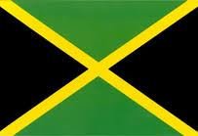
Jamaica and Caribbean Integration: Did One from Ten leave Nought?

Slide 2
Multiple Anniversaries of 2012
-Bi-centennial of the Independence of Jamaica and Trinidad and Tobago, on the 6th and 31st of August respectively.
-Initiation of the independence process for the wider Commonwealth Caribbean.
-Dissolution of the Federation of the West Indies and therefore..
-The beginning of a long road toward regionalization

Slide 3
End of the West Indian Federation
-Jamaican referendum was the instigator not the definitive cause of the Federation's collapse.
-Both political parties had Jamaican leadership.
- Lasted from 1958 to 1962
-Lacked customs union or common currency

Slide 4
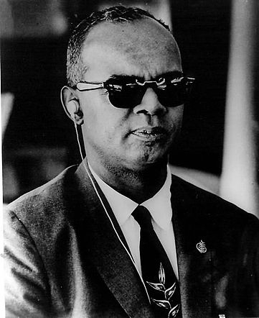
“...One from Ten leaves Nought...”
-Signalled Trinidad's departure from the Federation in response to Jamaica
-Left the “Little Eight” to fend for themselves
– Divided the MDC and LDCs.

Slide 5
CARICOM (est. 1973)
-Evolved from CARIFTA (1968)
-Coordination of Foreign Policies
-Functional Cooperation
-Economic Integration

Slide 6
Organisation of Eastern Caribbean States
-Treaty of Basseterre 1981
-Region Security System
-Eastern Caribbean Central Bank
-Eastern Caribbean Supreme Court
-OECS Secretariat
-Joint Diplomatic Representation
-Revised Treaty 2011 Provides for Full Economic Union

Slide 7
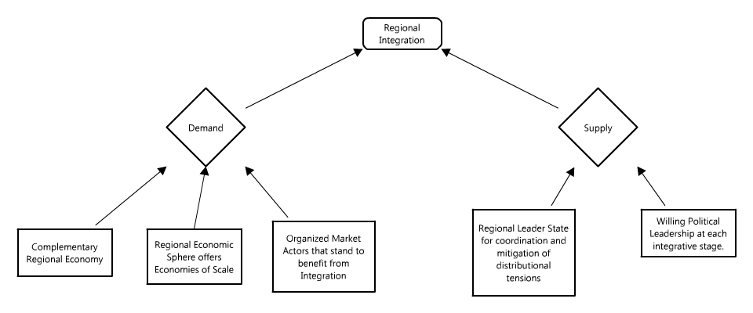
Assumptions about Caribbean Integration

Slide 8
The Next 50 Years
Greatest potential for more functional integration is at the 'sub-regional' level.
Change will be gradual, incremental, and driven by strategic interests.
OECS institutions have the potential to form the basis of a larger economic or political union within CARICOM.
Jamaican influence within the region will remain strong, but its participation will not be perceived as essential.

